Slide 1

KUETConnect: A Dynamic Android Application for Secure Real-time Interaction and Multimedia Sharing
CSE 3200: System Development Project
MD Rauful Islam Tamim
Roll:2007009
MD Tashibul Islam
Roll:2007011

Slide 2
Introduction
Exclusivity
KUET email verification ensures campus-only access.
Privacy
End-to-end encryption secure communications.
Simplicity
Distraction-free feeds

Slide 3
The Problem: Limitations of Open Social Platforms
Open To Anyone
Unwanted interactions from external users.
Constant Distractions & Noise
Feeds are cluttered with ads, suggested content, and endless notifications, making it hard to focus on genuine connections
Lack of Security Concerns
Significant privacy concerns with data monetization.

Slide 4
Motivation: Reclaiming Social Space
Overwhelming digital noise on public platforms.
Significant privacy concerns with data monetization.
Unwanted interactions from external users.
High social media use linked with worse well-being-PubMed
Heavy use associated with perceived social isolation-PubMed

Slide 5
Social App: Features
Authentication
Profile Picture & Cover Photo
Post
Story
News Feed
Like & Comment
Notification
Searching
Following

Slide 6
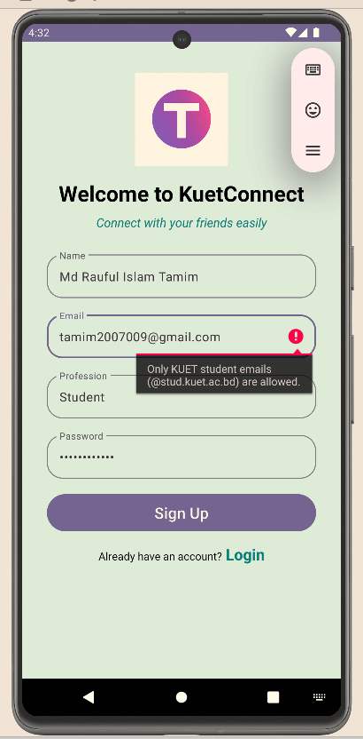
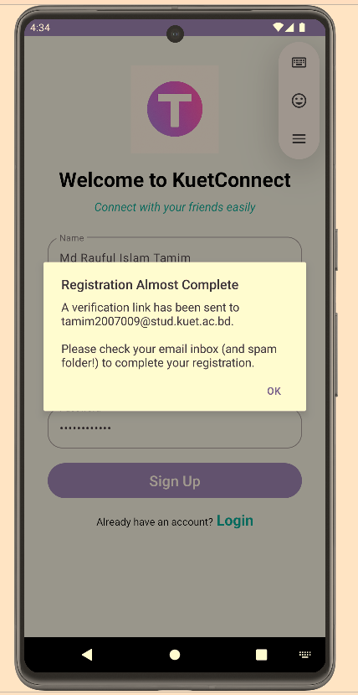
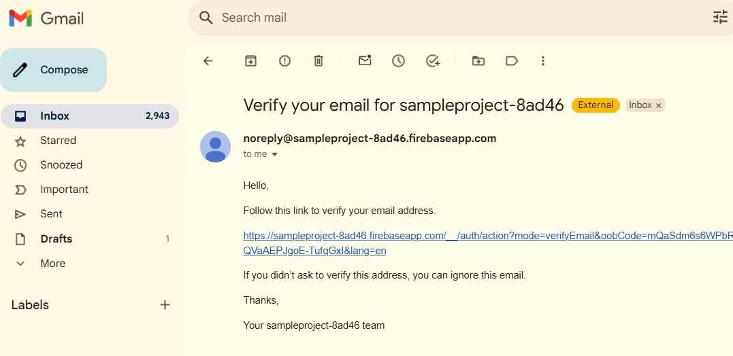
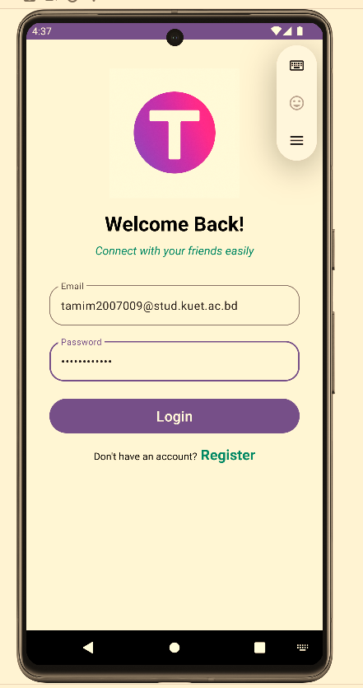
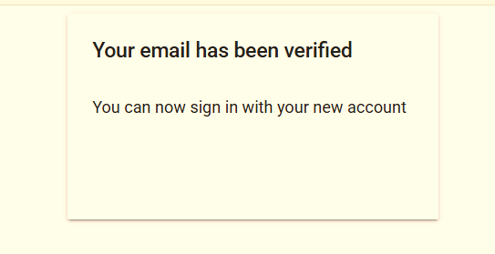
Authentication
Figure: Authentication flowpath

Slide 7
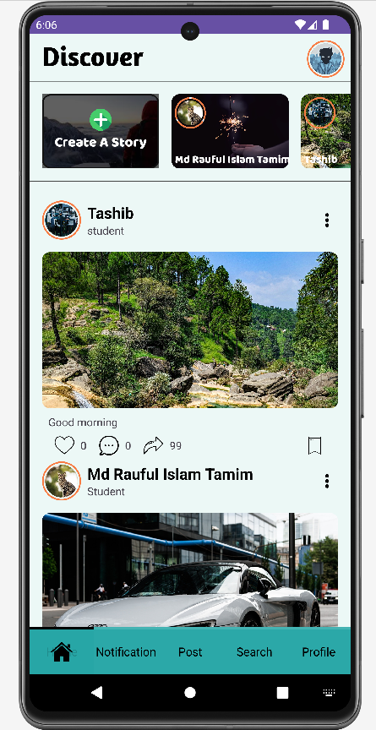
Feature Deep Dive: Distraction-Free Feed
No Advertisements: Experience a clean, ad-free browsing environment.
Follower-Centric: Only see content from users you explicitly follow.
Figure: Home-Feed

Slide 8
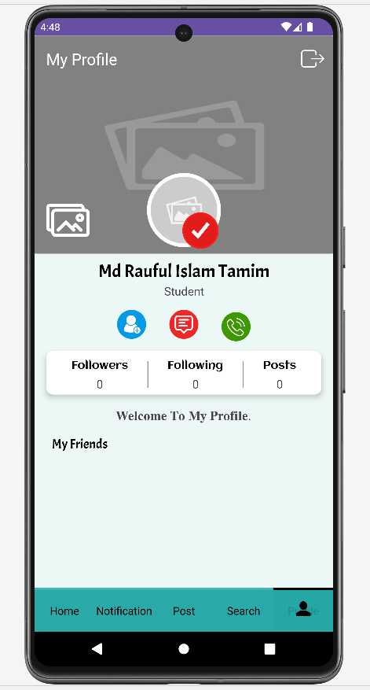
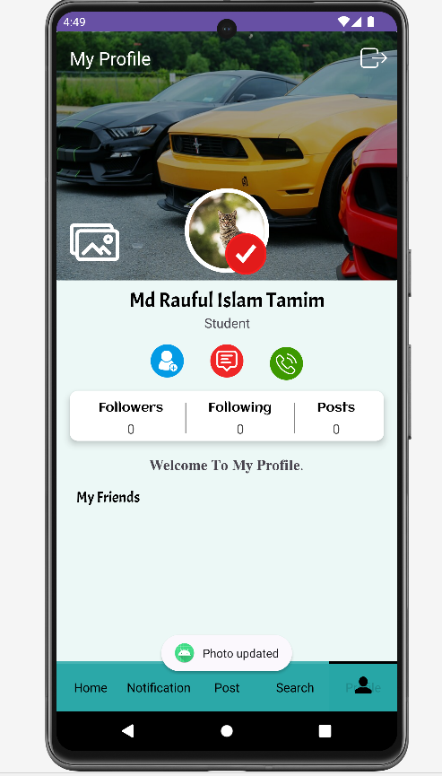
Profile Picture and Cover Photo
Figure: Profile flowpath

Slide 9
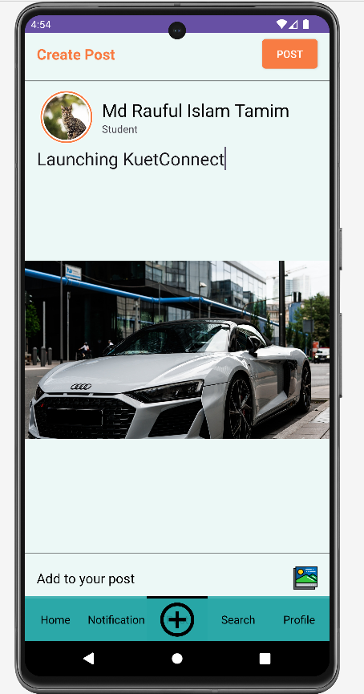
Create Post
Figure: Post flowpath

Slide 10
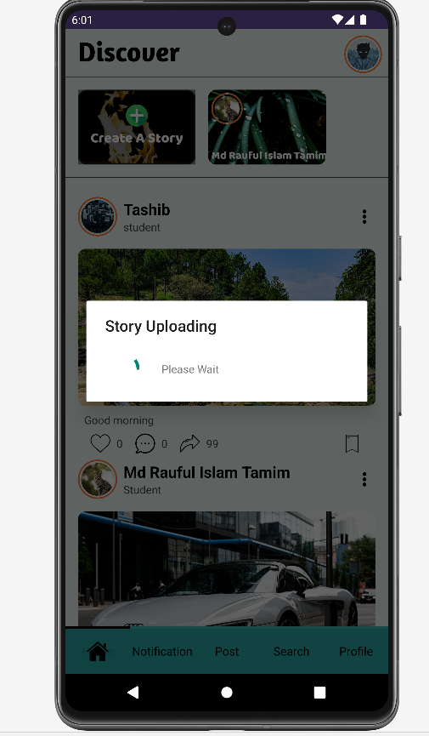
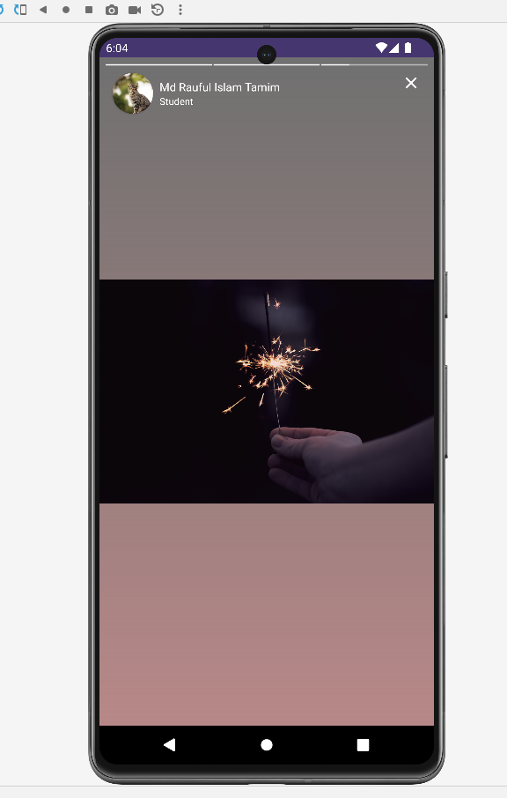
Story Upload
Figure: Story flowpath

Slide 11
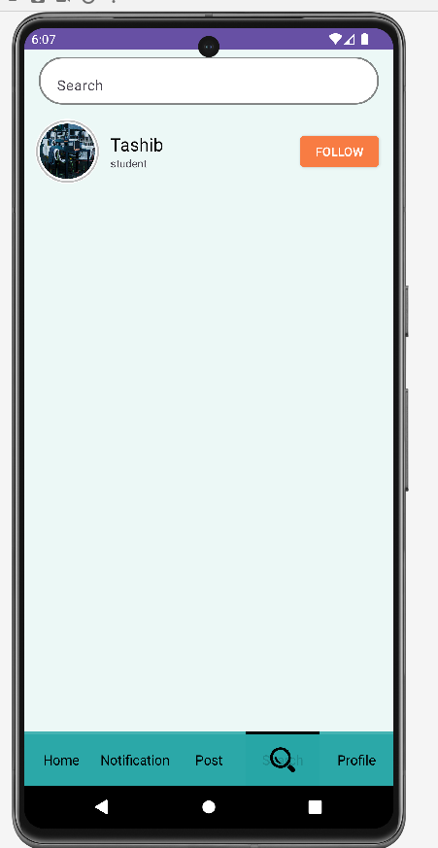
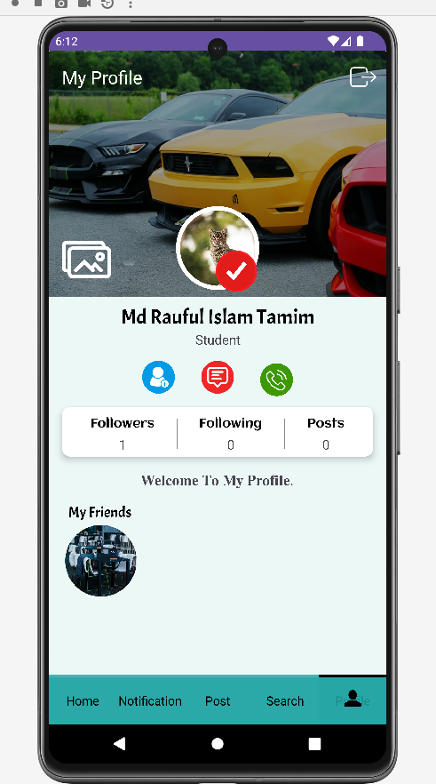
Search & Follow
Figure: Search & Follow flowpath

Slide 12
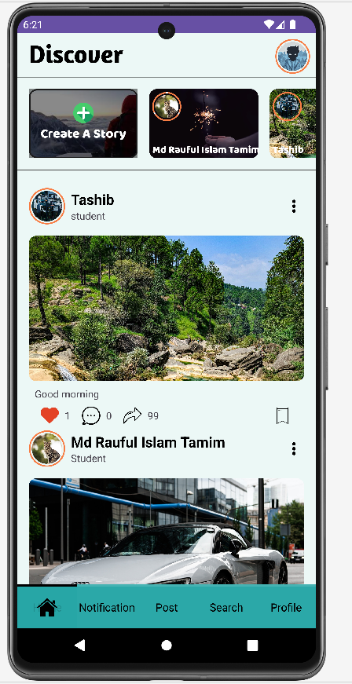
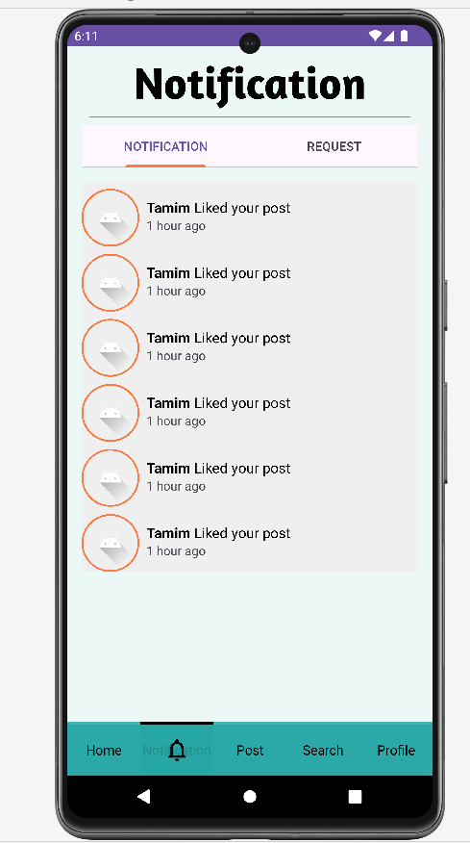
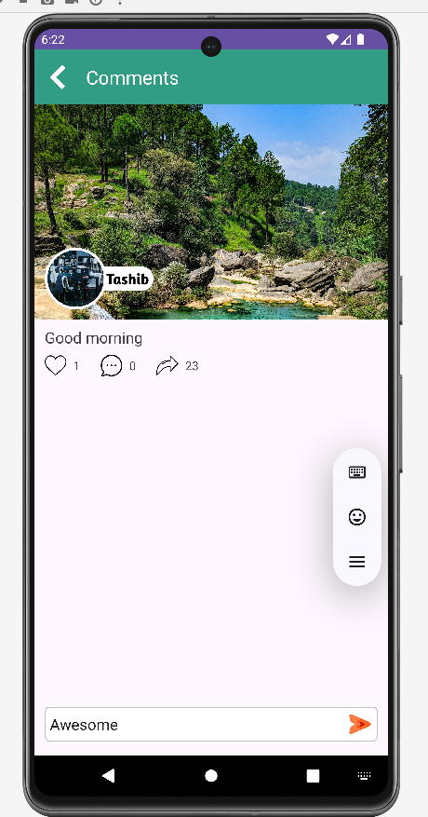
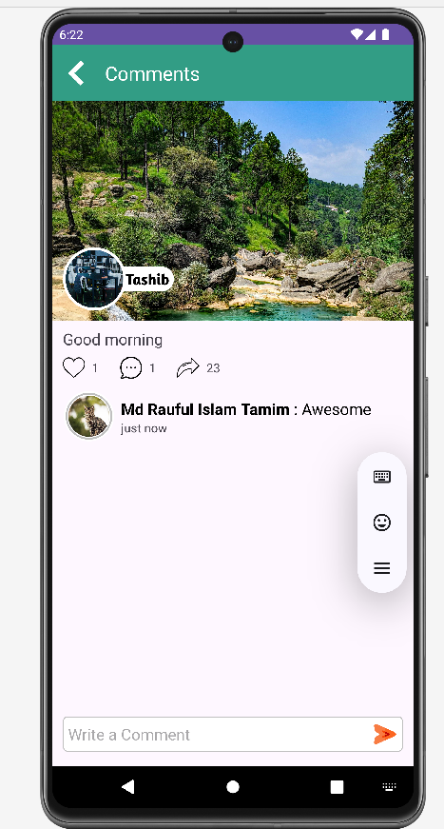
Like, Comment &Notification
Figure: Notification flowpath

Slide 13
Architectural Foundation: Technologies Behind KUETConnect
Platform Development
Backend Infrastructure
Native Android: Ensures optimal performance, responsiveness, and access to device-specific features.
Firebase Authentication: Secure and scalable user authentication, enforcing KUET email domain exclusivity.
Java: The primary programming language
Firebase Realtime Database: For real-time data synchronization and chat message persistence.
Android Studio: The integrated development environment (IDE) for streamlined development, debugging, and testing.
Firebase Storage: Reliable and scalable storage for multimedia content (photos, videos) shared within the application.

Slide 14
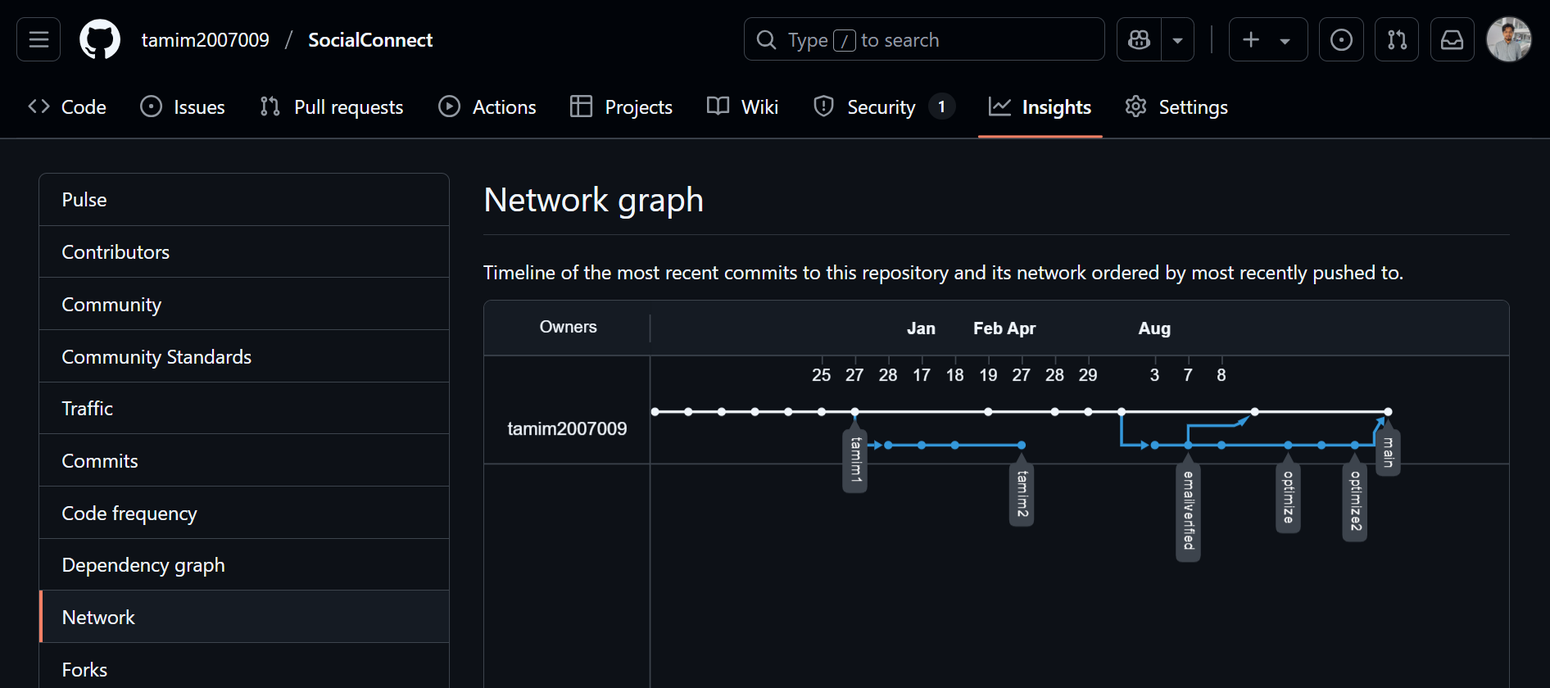
Architectural Foundation: Technologies Behind KUETConnect(Contd.)
Collaboration & Code Management
GitHub: A cloud-based platform for version control and collaborative code management platform
Figure:GitHub Network Graph

Slide 15
Addressing Data Privacy in Chat Applications
Rising Concerns over Data Privacy
High-profile data breaches
unauthorized surveillance
Lack of Content-Level Encryption in Common Apps
Not guaranteed that messages at rest are unreadable by the service provider or anyone who gains database access.

Slide 16
Chat app: Features
Ensure Confidentiality with End-to-End Encryption (E2EE)
Combining RSA (asymmetric) and AES (symmetric) algorithms
Enable Controlled Communication via Request Model System
Ensures only user-consented communication.
Notes:
to secure messages, images, and video URLs during transmission. This ensures that only the intended recipient can decrypt and read the communication,
, while utilizing background threads for intensive operations like media compression, encryption, and uploading, ensuring smooth user experience without UI lag.
Request accept and cancel Model
. This optimizes app performance and reduces data usage.
In addition to core security, we included features like active status indicators, block/delete conversation options, media preview/download, and profile/cover photo editing—all aimed at creating a polished user experience.

Slide 17
Additional Chat Enhancements for Seamless User Experience
Optimized Performance
Enhanced Media Handling
Message Pagination: Efficiently loads messages in batches of 20, ensuring smooth scrolling and reducing memory footprint.
Blur-to-Clear Preview: Media previews are initially blurred, clearing with the loading.
.
Fullscreen Viewer: Immersive viewing experience for shared photos and videos.
Active Status: Real-time indicators for online presence.
Chat Management: Options to block users or delete entire chat histories.
Download Option: Conveniently save received media directly to the device's gallery.

Slide 18
Tools
Cryptography Libraries
AES (Advanced Encryption Standard) from javax..crypto for fast, symmetric encryption of message content and URLs.
RSA from Java Security for secure, asymmetric encryption of AES session keys. We manage RSA key pairs per user.

Slide 19
Tools (contd.)
Multithreading & Permissions
Java Threads for CPU-intensive tasks (image,video compression, encryption, upload)
AndroidX’s permission API prompts for “Write External Storage”

Slide 20
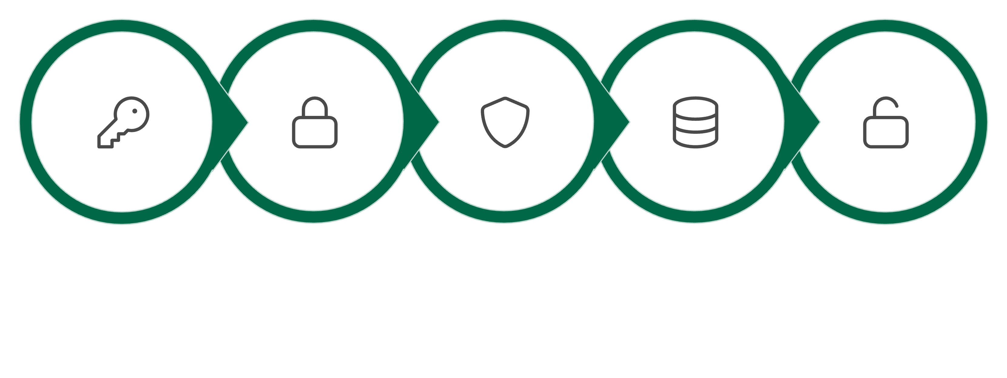





Encryption Workflow Diagram
This diagram illustrates the step-by-step process of our hybrid E2EE, ensuring message confidentiality.
Encrypt Message AES
Recipient Decrypts AES
Generate AES Key
Encrypt AES Key RSA
Store in Firebase
Figure: Encryption Process
This hybrid approach offers a robust balance of performance and cryptographic strength.

Slide 21
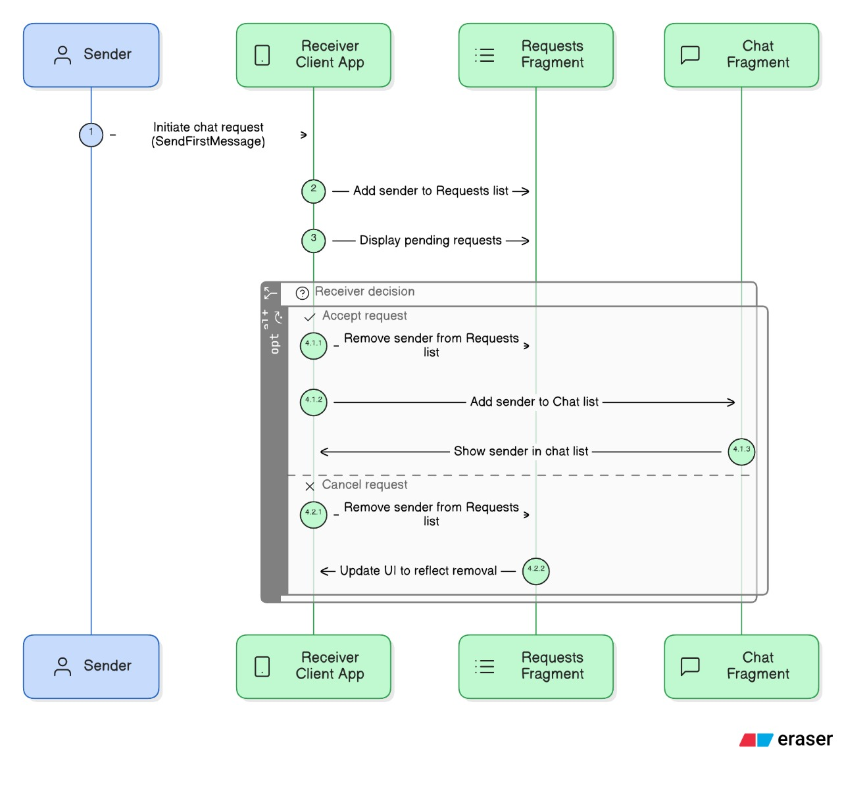
Chat Request System
Figure: Request flowpath

Slide 22
Chat Request System
First message creates a request entry in DB named ChatRequests
Receiver sees pending requests in Request Fragment with ‘Accept’ and ‘Cancel’ button
Accept → add requested users to recipient’s Chat list fragment and remove from Request fragment
Cancel → delete request without chat initiation

Slide 23
Decryption Workflow
Retrieve recipient's RSA private key from local storage
Decrypt AES key using the RSA private key
Decrypt message using the AES key
Show to recipient's UI

Slide 24
UI Components & Features of chat app
Chats, People, Requests fragments via ViewPager
Bottom navigation and drawer menu
Media preview: blur-to-clear with progress bar
Fullscreen media viewer with download option
Search, block, delete messages and conversations

Slide 25
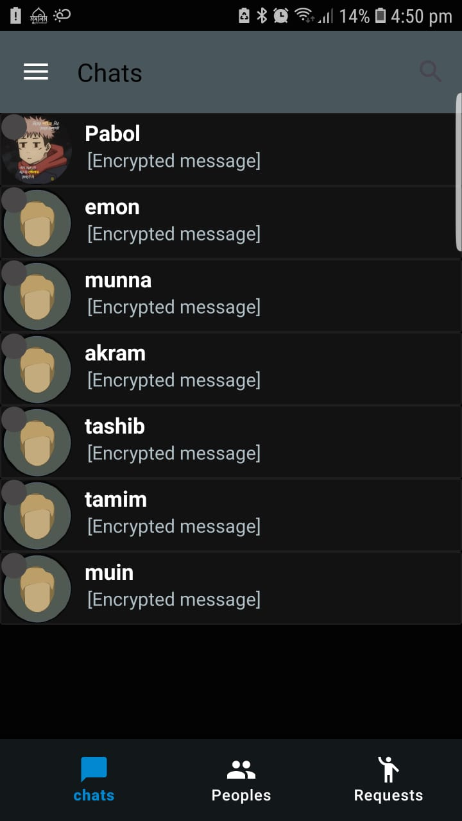
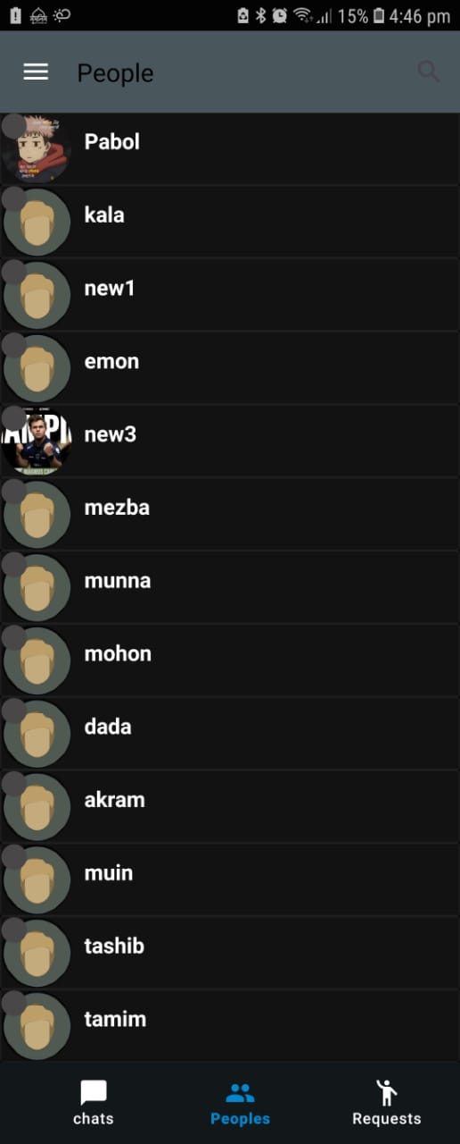
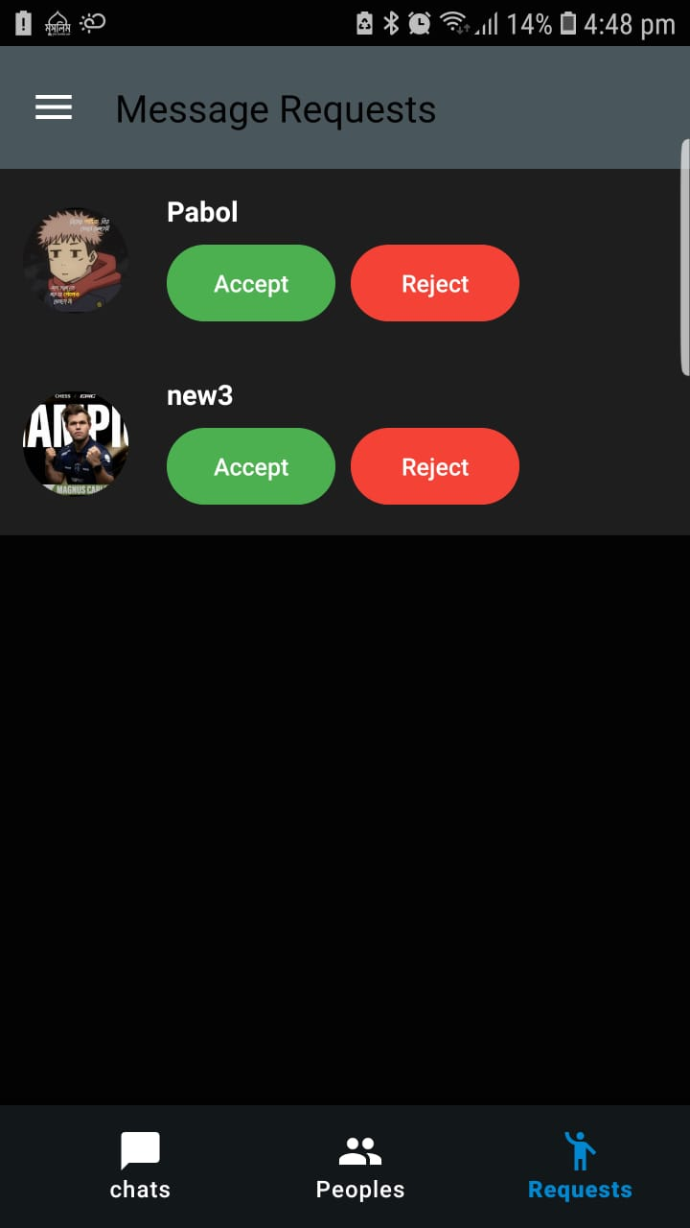
UI Components & Features
Fig: Chats Frag.
Fig: People Frag.
Fig: Requests Frag.
People
Requests

Slide 26
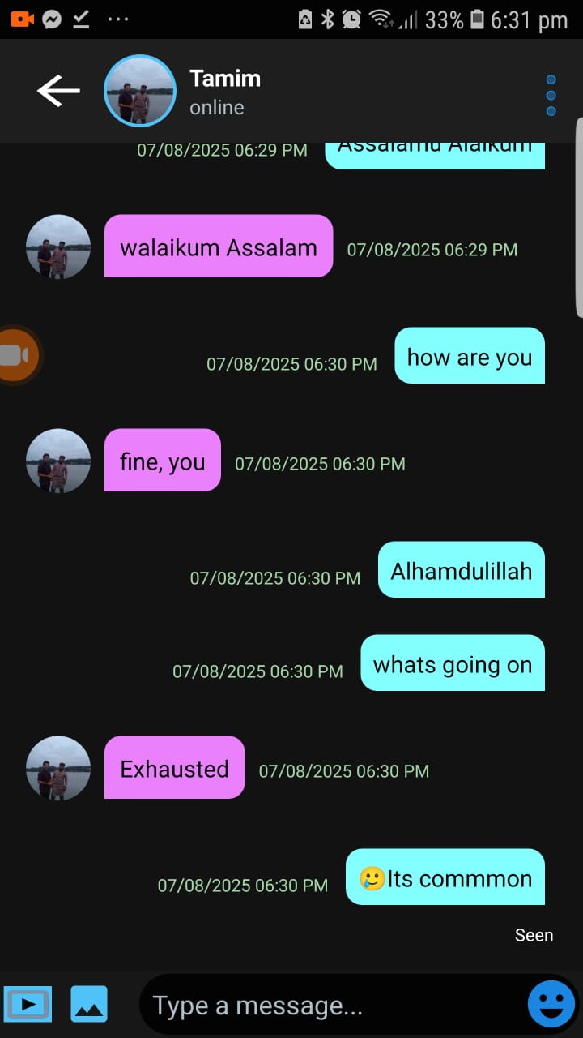
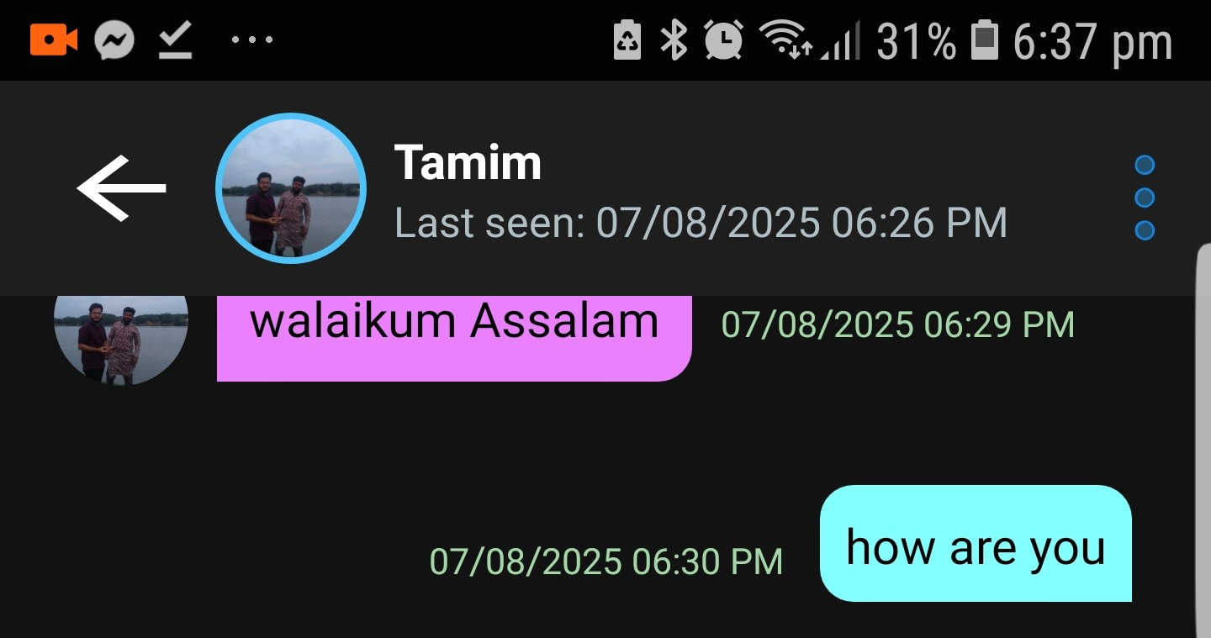
Sender & Reciever Inbox UI
Fig: Inbox UI

Slide 27
Results & Evaluation
Encrypted content not visible in Firebase console
Smooth media uploads with visual progress feedback
No UI freeze under stress with large media

Slide 28
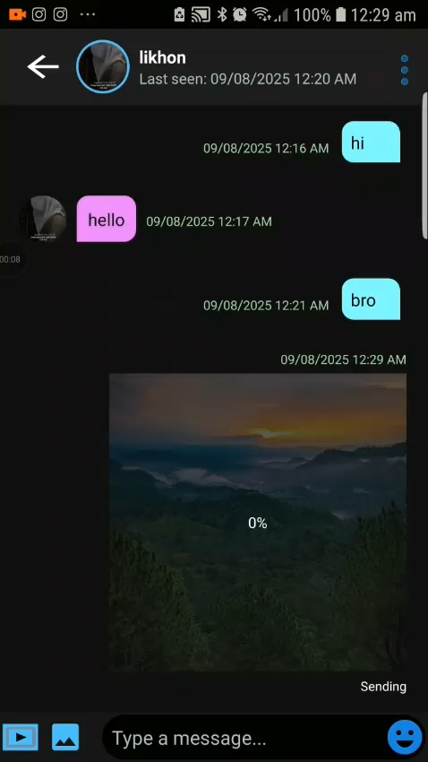
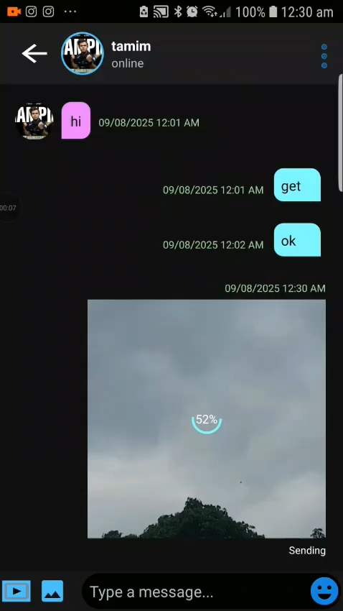
Media preview: blur-to-clear with progress bar
Fig: Image Sending
Fig: Video Sending

Slide 29
Conclusion
Established hybrid E2EE for text and media URLs
Ensured academic-only access for KUET community
Delivered robust, feature-rich chat experience
Demonstrated scalability and security

Slide 30
Feature Comparison with Real-life Apps
Feature | Our App | WhatsApp | Telegram | Signal
Hybrid RSA+AES End-to-End Encryption (Text + Media URLs) | ✅ | ❌ (AES only) | ❌ (MTProto) | ✅ (Signal Protocol)
Encrypted Media Download URLs (Not stored in plain text) | ✅ | ❌ | ❌ | ❌
Institutional Email-based Registration (Closed Community) | ✅ | ❌ | ❌ | ❌
Chat Request System for New Users | ✅ | ❌ | ❌ | ❌
Real-time Active Status with Last Seen in Inbox Header | ✅ | ✅ | ✅ | ✅
Fig: Comparison with Exsting Apps

Slide 31



Integration: Single Database
Figure: Integration

Slide 32
Future Scopes
Implement group chat with shared AES sessions
Support document/file sharing
Voice and Video Calling

Slide 33
Thank YOU

